Slide 1
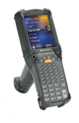
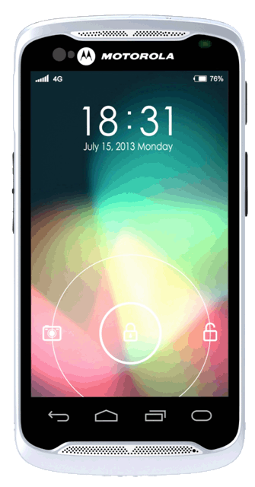
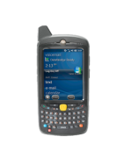
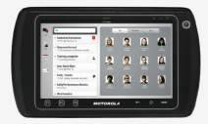
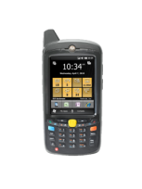
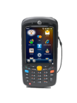
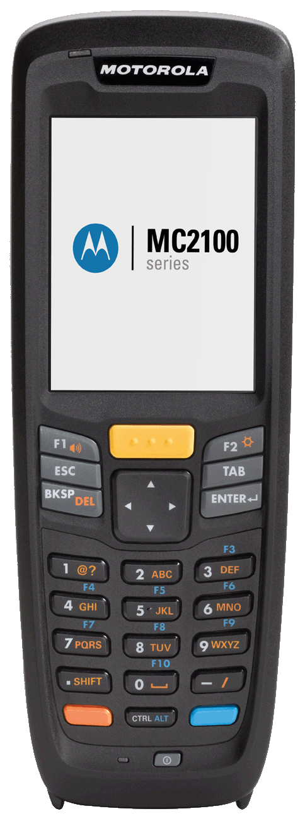
ADATGYŰTŐ PORTFÓLIÓ
CUSTOMER
FACING
FIELD MOBILITY
TASK
SPECIFIC
INDUSTRIAL
MOBILITY
PREMIUM
PERFORM.
MID-RANGE
VALUE
MC9200
Premium
MC95
XT15
TC70
TC55
MC9200
Standard
High
Configurability
MC9190
MC67
ET1
MC3200
Workabout Pro 4
MC40
MC65
MC3100
High
Configurability
MC55
SB1
MC45
MC2100

Slide 2
KNOWLEDGE WORKER CUSTOMER-FACING PORTFÓLIÓ
ÁRELLENŐRZÉS
TERMÉK INFORMÁCIÓK
RENDELÉSFELVÉTEL
& FIZETÉS
TERMÉK ÖSSZEHASONLÍTÁS,
TANÁCSADÁS
ÉRTÉKESÍTÉS & SZERVÍZ

Slide 3
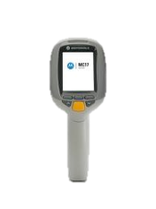
CUSTOMER FACING
MC17/MC18
SB1
MC40
ET1
TC55
TC70
PLATFORM | MC17: Intel PXA270 520 MHz MC18: TI OMAP4 800 MHz | i.MX35 | OMAP4 800MHz Dual Core | OMAP 4 Dual Core 1GHz x 2 + DSP | 1.5 GHz Dual Core, Qualcomm 8960 | Dual Core, 1.7GHz, QC 8060
OS | MC17: CE 5.0 Professional MC18: WEC7 | Thin client architecture and standard web technology | Android 4.1 | Android 4.1 | Android JB 4.1 | Android AOSP 4.4.2 (KitKat)
DISPLAY | MC17: 2.8”, 320 x 240 MC18: 4.0”, 480 x 800 | E Ink Display and Full Touch Interface, 3 inch landscape 320x240 | 4.3” Capacitive | 7” 1024 * 600 capacitive display | 4.3” WVGA | 4.7”, 1280 x 720, optically bonded touch panel
NETWORK | MC17: 802.11a/b/g MC18: 802.11 a/b/g/n | 802.11 b/g/n | 802.11 a/b/g/n/r | 4G (HSPA+) and 3.5G (EVDO) 802.11 a/b/g/n | LTE 4G ATT HSPA+ ROW Verizon LTE 4G Q2 2014 | 802.11a/b/g/n/d/h/i
DATA CAPTURE / CAMERA | MC17: 1D Scanner MC18: 2D Imager | 1D and 2D Barcode scanning with integrated aimer and illumination | 1D/2D Imager 8 MP AF | 1D / 2D option Optional MSR w/encrypted head SKU 8MP AF | 1D imager, Camera for 2D, NFC Standard, 8 MP AF | 1D, 2D, SE4700 Megapixel Imager MSR NFC
RUGGED | 1.2 m Drop, 5m Tumble | 4ft drop tile/concrete, IP54 | IP54 4’ drop | IP54 sealing Multiple 4’ drop per MIL-810-G | IP67, 4’ drop | IP67 sealing 1.8m drop 2.4m, 2,000 1M tumbles

Slide 4
KNOWLEDGE WORKER FIELD
MOBILITY PORTFÓLIÓ
POSTA &
CSOMAGSZÁLLÍTÁS
ÁRUKISZÁLLÍTÁS
FIELD SALES & SZERVÍZ
KÖZBIZTONSÁG & KORMÁNYZAT

Slide 5
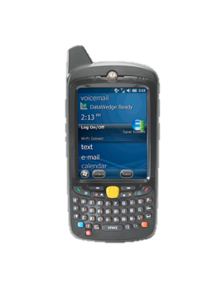
FIELD MOBILITY ESZKÖZÖK
MC45
TC55
MC67
MC95
PLATFORM | 600MHz MSM7627 | Qualcomm MSM8260 DC,1.5GHz | 1GHz Dual Core OPAP4 | 806MHz PXA320
OS | WEHH 6.5.3 | Android 4.1.2 w/wo GMS, Mx | WEHH 6.5.3 Android 4.1 | WEHH 6.5.3
DISPLAY | 3.2” QVGA | 4.3”, 800 x 480, Capac., 700 NITS, Glove, wet use | 3.5” VGA | 3.7” VGA TFT
WAN | 3.5G GSM | GSM: LTE Voice & Data CDMA: LTE Data Only, 3G V & D | HSPA+ 4G or CDMA EVDO Verizon (NA Only) | HSDPA, Gobi or EVDOrA
802.11 LAN | a/b/g | a/b/g/n | a/b/g/n | a/b/g
DATA CAPTURE | Y | 1D Imager, 1D/2D Camera, NFC, MPM 2D Imager Q1 ’15 | 1D / 2D Imager | 1D Laser or 2D Imager
CAMERA | 3.2 MP | 8MP | 8MP AF | 3.0 MP
RUGGED | IP64 | IP54 | IP67, 8’ drop | IP67, 6’ drop

Slide 6
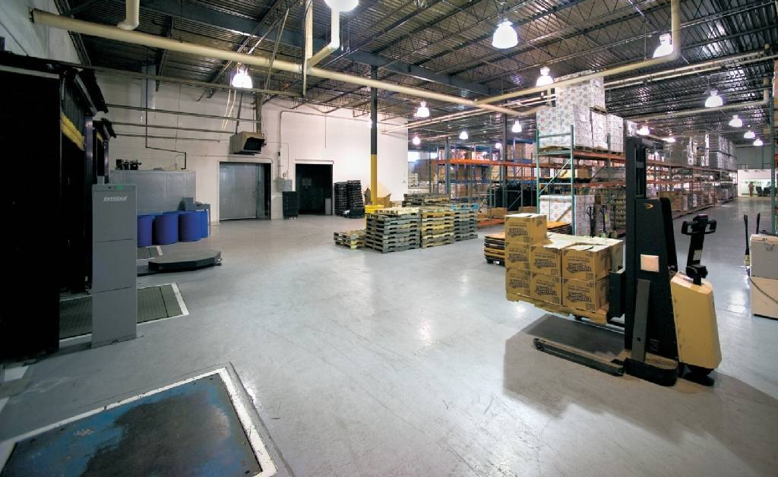
LINE WORKER PORTFÓLIÓ
LOGISZTIKA &
RAKTÁROZÁS
KÉSZLETKEZELÉS
LELTÁROZÁS
GYÁRTÁS

Slide 7
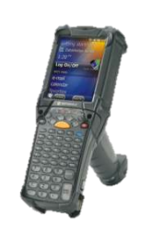
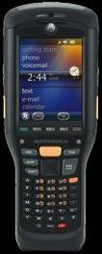
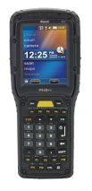
LINE WORKER
 | MC21XX | MC3X00 | WAP4 | MC9190 | MC9200 | MC9500 | XT15
Form factor | Brick | Gun, Str Shtr, Rot | Brick (Pistol Grip optional/field installable) | Gun only (integrated handle) | Gun only Integrated handle | Brick(Snap on trigger available) | Brick (Bolt on trigger available)
CPU | 624MHz PXA320 (MPA2) | MC31: Marvell PXA320, 624 MHz MC32 PREM: 1GHz Dual Core Proc. MC32 STD: 800MHz | TI Sitara AM37x ARM Cortex –A8 1 GHz | PXA320 806MHz | TI OMAP 4430 1GHz | PXA320 806MHz | TI AM3715 800MHz
Memory | 128 MB RAM/256 MB ROM; microSD card slot up to 32GB) | MC31: 256MB RAM 1GB Flash MC32 PREM: 1GB/4GB MC32 STD: 512 MB/2GB SD card up to 32GB (MC31), 64GB (MC32) | 512MB RAM 4GB Flash SD card up to 32GB | 256MB RAM 1GB Flash SD card up to 32GB | 512MB or 1GB RAM 2 GB Flash SDHC up to 64GB | 256MB RAM 1GB Flash SD card up to 32GB | 512MB RAM 1GB Flash microSD card up to 32GB
OS | Win CE 6.0 | MC31: Win CE 6.0 WEHH 6.5.3 MC32 PREM: CE7, Android 4.1.1 with Mx MC32 STD: CE7.0 | Windows® CE 6.0, WEH 6.5 | Win CE 6.0 WEHH 6.5.3 | Win CE 7.0 WEHH6.5.3 | Win CE 6.0 WEHH 6.5.3 | Win CE 6.0 WEHH 6.5.3
WAN | none | N/A | Optional 3.8G HSPA+ | N/A | N/A | 3.5G HSDPA/CDMA EVD0-Rev A | 3.8G HSPA+
WLAN | 802.11b/g/n | MC31: 802.11 a/b/g MC32: 802.11 a/b/g/n | 802.11 a/b/g/n | 802.11 a/b/g | 802.11 a/b/g/n | 802.11 a/b/g | 802.11 a/b/g/n
Display | 2.8” QVGA | 3”, 320 x 320 TFT | 3.7” VGA | 3.7” VGA (QVGA capable on CE6.0 units) | 3.7” VGA (QVGA capable on CE7.0 units) | 3.7” VGA | 3.7” VGA (QVGA capable on CE 6.0 units)
IP Rating | IP54 | IP54 | IP65 | IP54 | IP54 | IP67 | IP67
Drop Spec | 4’ drop | 4ft to concrete | 6ft to concrete | 6ft to concrete | 6ft to concrete | 6ft to concrete | 6.5ft to concrete

